Slide 1
Computer science is a field of study that deals with solving a variety of problems by using computers.
To solve a given problem by using computers, you need to design an algorithm for it.
Multiple algorithms can be designed to solve a particular problem.
An algorithm that provides the maximum efficiency should be used for solving the problem.
The efficiency of an algorithm can be improved by using an appropriate data structure.
Data structures help in creating programs that are simple, reusable, and easy to maintain.
This module will enable a learner to select and implement an appropriate data structure and algorithm to solve a given programming problem.
Notes:
Student already have learnt about SCDs in Module I. Therefore, you can start this topic by asking the following questions to students:
What are type 1 SCDs?
Given an example to explain type 1 SCDs.
This will recapitulate what they have learnt about type 1 SCD in Module 1.
Now explain the strategy to load the data into these dimension tables with help of the given diagram. Relate this diagram to the example given in SG.

Slide 2
In this session, you will learn to:
Explain the role of data structures and algorithms in problem solving through computers
Identify techniques to design algorithms and measure their efficiency

Slide 3
Role of Algorithms and Data Structures in Problem Solving
Problem solving is an essential part of every scientific discipline.
Computers are widely being used to solve problems pertaining to various domains, such as, banking, commerce, medicine, manufacturing, and transport.
To solve a given problem by using a computer, you need to write a program for it.
A program consists of two components, algorithm and data structure.
Notes:
To start the session, you need to get a set of playing cards in the class. Follow the instructions as given below to begin the game of Rummy.
1. The game begins by dealing a fixed number of cards to all players. The remaining cards are placed face down to form a “stock” pile.
2. There is also a face-up pile called the “discard” pile.
3. Initially, the discard pile contains only one card which is obtained by picking the topmost card from the stock pile.
4. Each player can draw either the topmost card of the stock pile or the topmost card on the discard pile to make a valid sequence in his/her hand.
5. After this, the player must discard one card on top of the discard pile.
6. The next player, can then draw either the topmost card of the draw pile or the topmost card of the discard pile.
7. Therefore, if a player has to draw a card from the discard pile, he/she can draw only the topmost card of the discard pile.
8. Similarly, when a player has to discard a card, he/she must discard it on the top of the discard pile.
9. The discard pile can therefore be considered a Last-In-First-Out list.
10. The last card placed on top of the discard pile is the first one to be drawn.
11. To represent and manipulate this kind of a discard pile in a computer program, you would like to use a list that:
a. Contains the details of all the cards in the discard pile.
b. Implements insertion and deletion of card details in such a way that the last inserted card is the first one to be removed.
This kind of a list can be implemented by using a stack.
Ask students to define a stack?
Ask them to refer to the game and come up with some characteristics of a stack.
Then come to next slide and give them the definition of stacks.

Slide 4
Role of Algorithms
The word algorithm is derived from the name of the Persian mathematician Al Khwarizmi.
An algorithm can be defined as a step-by-step procedure for solving a problem.
An algorithm helps the user arrive at the correct result in a finite number of steps.

Slide 5
Role of Algorithms (Contd.)
An algorithm has five important properties:
Finiteness
Definiteness
Input
Output
Effectiveness

Slide 6
Role of Algorithms (Contd.)
A problem can be solved using a computer only if an algorithm can be written for it.
In addition, algorithms provide the following benefits:
Help in writing the corresponding program
Help in dividing difficult problems into a series of small solvable problems
Make decision making a more rational process
Help make the process consistent and reliable

Slide 7
Role of Data Structures
Different algorithms can be used to solve the same problem.
Some algorithms may solve the problem more efficiently than the others.
An algorithm that provides the maximum efficiency should be used to solve a problem.
One of the basic techniques for improving the efficiency of algorithms is to use an appropriate data structure.
Data structure is defined as a way of organizing the various data elements in memory with respect to each other.

Slide 8
Role of Data Structures (Contd.)
Data can be organized in many different ways. Therefore, you can create as many data structures as you want.
Some data structures that have proved useful over the years are:
Arrays
Linked Lists
Stacks
Queues
Trees
Graphs
Notes:
You can give some more explanation of stacks by with the help of the following example.
1. A stack is like an empty box containing books, which is just wide enough to hold the books in one pile.
2. The books can be placed as well as removed only from the top of the box.
3. The book most recently put in the box is the first one to be taken out.
4. The book at the bottom is the first one to be put inside the box and the last one to be taken out.

Slide 9
Role of Data Structures (Contd.)
Use of an appropriate data structure, helps improve the efficiency of a program.
The use of appropriate data structures also allows you to overcome some other programming challenges, such as:
Simplifying complex problems
Creating standard, reusable code components
Creating programs that are easy to understand and maintain

Slide 10
Types of Data Structures
Data structures can be classified under the following two categories:
Static: Example – Array
Dynamic: Example – Linked List

Slide 11
Just a minute
An array is a ___________ data structure, and a linked list is a ____________ data structure.
Answer:
static, dynamic
Notes:
In this slide you need to show the calculation to determine the sum of an arithmetic progression for bubble sort algorithm. Refer to student guide.

Slide 12
Identifying Techniques for Designing Algorithms
Two commonly used techniques for designing algorithms are:
Divide and conquer approach
Greedy approach

Slide 13
Identifying Techniques for Designing Algorithms (Contd.)
Divide and conquer is a powerful approach for solving conceptually difficult problems.
Divide and conquer approach requires you to find a way of:
Breaking the problem into sub problems
Solving the trivial cases
Combining the solutions to the sub problems to solve the original problem

Slide 14
Identifying Techniques for Designing Algorithms (Contd.)
Algorithms based on greedy approach are used for solving optimization problems, where you need to maximize profits or minimize costs under a given set of conditions.
Some examples of optimization problems are:
Finding the shortest distance from an originating city to a set of destination cities, given the distances between the pairs of cities.
Finding the minimum number of currency notes required for an amount, where an arbitrary number of notes for each denomination are available.
Selecting items with maximum value from a given set of items, where the total weight of the selected items cannot exceed a given value.

Slide 15
Just a minute
The ___________ technique involves selecting the best available option at each step.
Answer:
Greedy
Notes:
In this slide you need to show the calculation to determine the sum of an arithmetic progression for bubble sort algorithm. Refer to student guide.

Slide 16
Designing Algorithms Using Recursion
Recursion:
Refers to the technique of defining a process in terms of itself
Is used to solve complex programming problems that are repetitive in nature
Is implemented in a program by using a recursive procedure or function. A recursive procedure or function is a function that invokes itself
Is useful in writing clear, short, and simple programs

Slide 17
Just a minute
Identify the problem in the following algorithm that attempts to find the sum of the first n natural numbers:
Algorithm: Sum (n)
1. s = n + Sum(n – 1)
2. Return (s)
Answer:
There is no terminating condition in the given recursive algorithm. Therefore, it will call itself infinitely. The correct algorithm would be:
1. If (n = 1)
Return(1)
2. s = n + Sum(n – 1)
3. Return(s)
Notes:
In this slide you need to show the calculation to determine the sum of an arithmetic progression for bubble sort algorithm. Refer to student guide.

Slide 18
Determining the Efficiency of an Algorithm
Factors that affect the efficiency of a program include:
Speed of the machine
Compiler
Operating system
Programming language
Size of the input
In addition to these factors, the way data of a program is organized, and the algorithm used to solve the problem also has a significant impact on the efficiency of a program.

Slide 19
Determining the Efficiency of an Algorithm (Contd.)
The efficiency of an algorithm can be computed by determining the amount of resources it consumes.
The primary resources that an algorithm consumes are:
Time: The CPU time required to execute the algorithm.
Space: The amount of memory used by the algorithm for its execution.
The lesser resources an algorithm consumes, the more efficient it is.

Slide 20
Time/Space Tradeoff
Time/Space Tradeoff:
It refers to a situation where you can reduce the use of memory at the cost of slower program execution, or reduce the running time at the cost of increased memory usage.
Example is data storage in compressed/uncompressed form.
Memory is extensible, but time is not. Therefore, time considerations generally override memory considerations.

Slide 21
Method for Determining Efficiency
To measure the time efficiency of an algorithm, you can write a program based on the algorithm, execute it, and measure the time it takes to run.
The execution time that you measure in this case would depend on a number of factors such as:
Speed of the machine
Compiler
Operating system
Programming language
Input data
However, we would like to determine how the execution time is affected by the nature of the algorithm.

Slide 22
Method for Determining Efficiency (Contd.)
The execution time of an algorithm is directly proportional to the number of key comparisons involved in the algorithm and is a function of n, where n is the size of the input data.
The rate at which the running time of an algorithm increases as a result of an increase in the volume of input data is called the order of growth of the algorithm.
The order of growth of an algorithm is defined by using the big O notation.
The big O notation has been accepted as a fundamental technique for describing the efficiency of an algorithm.

Slide 23
Method for Determining Efficiency (Contd.)
The different orders of growth and their corresponding big O notations are:
Constant - O(1)
Logarithmic - O(log n)
Linear - O(n)
Loglinear - O(n log n)
Quadratic - O(n²)
Cubic - O(n³)
Exponential - O(2^{n}), O(10^{n})

Slide 24
Selecting an Efficient Algorithm
According to their orders of growth, the big O notations can be arranged in an increasing order as:
O(1) < O(log n) < O(n) < O(n log n) < O(n²) < O(n³) < O(2^{n})
< O(10^{n})
Graphs depicting orders of growth for various big O notations:

Slide 25
Group Discussion: Dependence of Efficiency on Selected Algorithm
Problem Statement:
You need to write an algorithm to search for a given word in a dictionary. Discuss how different algorithms and different ways of organizing the dictionary data affect the efficiency of the process.

Slide 26
Summary
In this session, you learned that:
An algorithm can be defined as a step-by-step procedure for solving a problem that produces the correct result in a finite number of steps.
An algorithm has five important properties:
Finiteness
Definiteness
Input
Output
Effectiveness
An algorithm that provides the maximum efficiency should be used for solving the problem.

Slide 27
Summary (Contd.)
Data structures can be classified under the following two categories:
Static
Dynamic
Two commonly used techniques for designing algorithms are:
Divide and conquer approach
Greedy approach
Recursion refers to a technique of defining a process in terms of itself. It is used to solve complex programming problems that are repetitive in nature.
The primary resources that an algorithm consumes are:
Time: The CPU time required to execute the algorithm.
Space: The amount of memory used by the algorithm for execution.

Slide 28
Summary (Contd.)
Time/space tradeoff refers to a situation where you can reduce the use of memory at the cost of slower program execution, or reduce the running time at the cost of increased memory usage.
The total running time of an algorithm is directly proportional to the number of comparisons involved in the algorithm.
The order of growth of an algorithm is defined by using the big O notation.

Slide 29
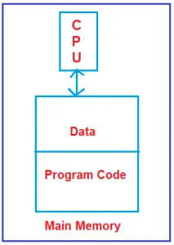
What are Data Structures?
An algorithm is a set of one–by–one instruction to solve a particular problem.
A program is a set of instructions that performs operations on data. So without data, instructions cannot be performed. Data is the most important aspect of a program. So when a program is dealing with the data, how it will organize the data in the main memory, is called the data structure. That means the way we organize the data in the main memory during the execution time of a program is called the data structure.

Slide 30
What are the lists of data structures?
Physical Data Structures: They define how the data is arranged in memory. Examples are given below.
Arrays
Matrices
LinkedList
Logical Data Structures: They define how the data can be utilized.
Stack
Queues
Trees
Graph
Hashing

Slide 31
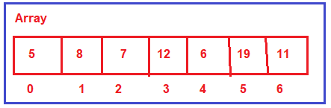
Physical Data Structure:
We call array and linked list as the physical data structure because these two data structures decide or define how the memory is organized or how the memory is allocated.
Array: The Array is a collection of contiguous memory locations i.e. all these locations are side by side. They are in one place. The array will have a fixed size. Once it is created with some size, then that size cannot be increased or decreased. So, it is a fixed size i.e. the size of the array is static.

Slide 32
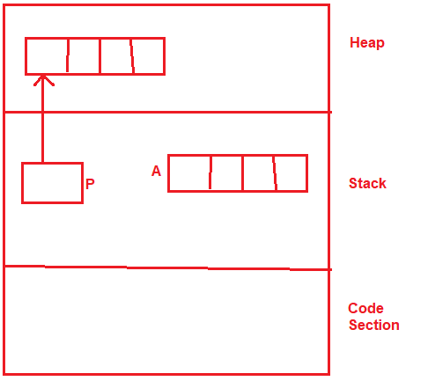
Where the array can be created?
The array can be created either inside the stack or it can be created inside the heap.
We can have a pointer, pointing to the array created on the heap.
So, the array can be created either inside the stack or inside the heap.

Slide 33
When to use the array data structure?
We need to use the array data structure when we are sure what is the maximum number of elements that we are going to store.
That means if we know the length of the list then we need to go for the array data structure.

Slide 34
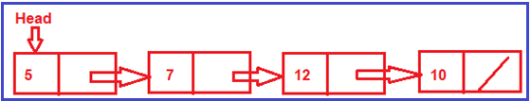
Linked list:
The Linked List data structure is a completely dynamic data structure.
It is a collection of nodes where each node contains data and a link to the next node.
The length of the linked list can grow and reduce dynamically. So, it is having a variable length.
As per our requirement, you can go on and adding more and more nodes and add more elements or you can reduce the size.

Slide 35
When to use the Linked List data structure?
We need to go with the linked list data structure when we are not sure what is the maximum number of elements that we are going to store.
That means if we don’t know the length of the list then we need to go for the linked list data structure.

Slide 36
Difference between the logical data structure and the physical data structure:
Physical Data structure:- Any data structure for which memory is allocated.
It decides or defines how the memory is organized or allocated.
Logical Data Structure:- Those data structure for which there is no memory allocated directly (like stack, queues etc.), but by using physical data structure
(array, linked-list) we can allocate the memory.
OR
Those data structures which is implemented by using physical data
structures are called Logical data structures.

Slide 37
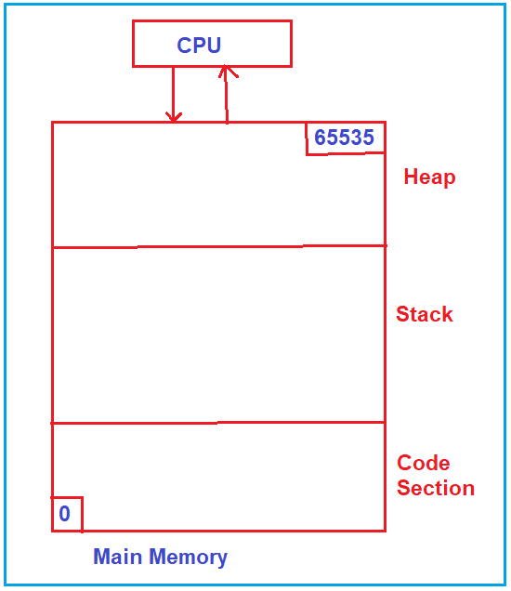
How Program Uses Main Memory?
A program uses the main memory by dividing it into three sections i.e. code, stack, and heap.

Slide 38
Let us see how the program utilizes the main memory i.e. the three sections of the main memory.
See the steps below:
We have a program on the hard disk.
If we want to run this program, then this program i.e. the machine code of the program, first should be brought inside the main memory i.e. brought inside the code section of the Main memory.
The area where the machine code of the program is reside called as Code Section of the Main memory.
Once the machine code is loaded in the Code Section, then the CPU will start executing the program, and the program then will utilize the remaining memory i.e. stack and heap.

Slide 39
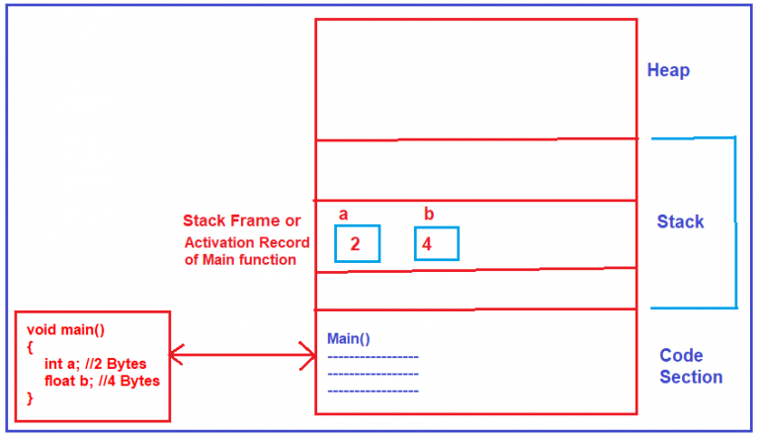
How does the stack and heap memory work?

Slide 40
Note: The point that you need to remember is whatever variables we declare inside our program or inside a function, the memory for those variables will be allocated inside the stack. So, the portion of memory that is given to the function is called an activation record of that function.
What is static memory allocation?
So, how the memory is allocated inside the stack is depends on whatever variables we have inside a function. The size of the memory required by a function was decided at compile-time only by the compiler and that memory is obtained once the program start executing & it is obtained inside the stack, we say this is static memory allocation.

Slide 41
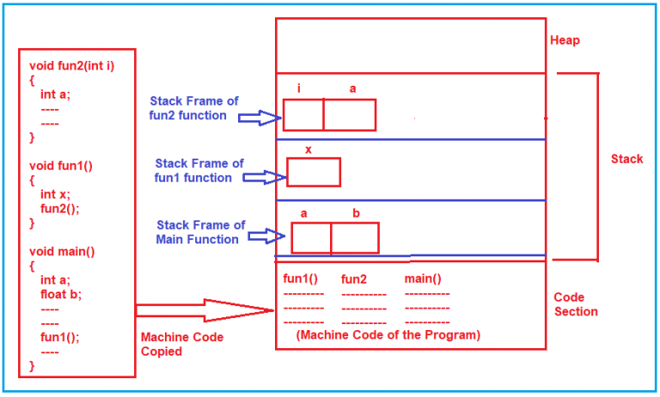
If there is a sequence of function calls then how the memory is allocated inside the stack? See the diagram below:

Slide 42
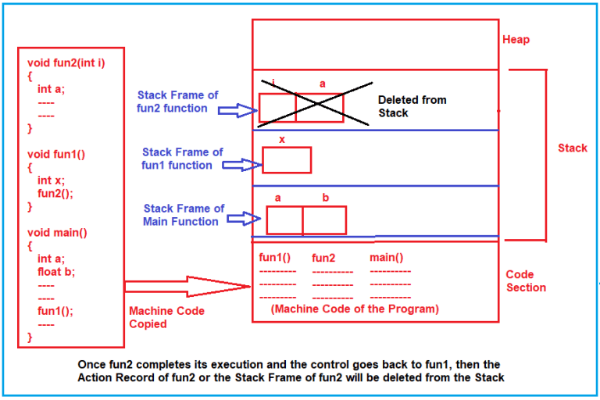

Slide 43
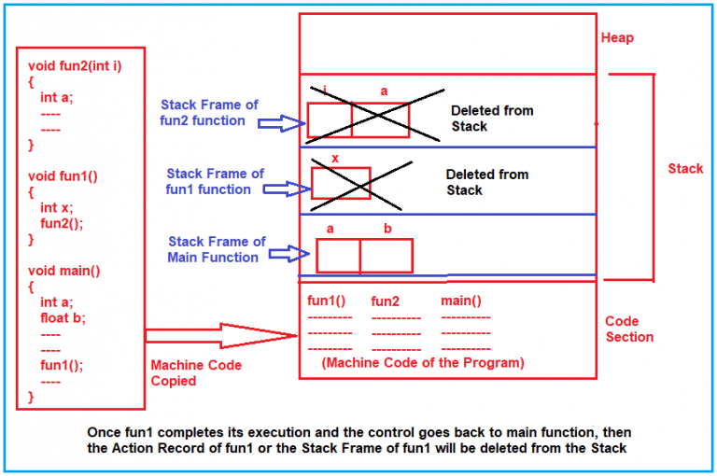

Slide 44
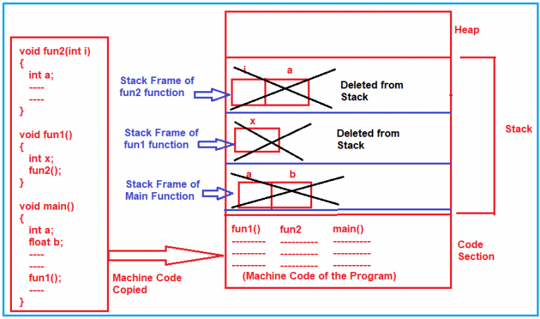

Slide 45
How much memory is required by a function?
How much memory is required by a function is depends on the number of variables and their sizes and this is decided by the compiler only.
The stack memory is automatically created as well as automatically destroyed.
The programmer doesn’t have to do anything for its allocation and destruction, just the programmer has to declare the variable.
So, the conclusion is whatever the variables we declare in the program or whatever the parameters our functions are taking for all of them, the memory is allocated inside the stack and it is automatically created and automatically destroyed when the function ends.

Slide 46
Heap Memory:
Heap is the term used for unorganized memory.
It is not organized.
The stack memory is organized and we already saw how the activation records are created and deleted.
Heap is that heap memory should be treated as a resource.
Let us first understand what do you mean by resource. A printer is a resource for your program. If your program wants to use a printer, then it can request a printer and use the printer. Once it has finished using it, it should release the printer. So that the other applications can use it.

Slide 47
In the same way, the heap memory should be used as a resource.
When required you take the memory and when you don’t require it, release the memory.
This is the practice that we must do while dealing with heap memory.
The program can’t directly access heap memory.
The Program can directly access anything inside the code section, anything inside the stack but cannot access the heap memory directly.
Then how the program will access the heap memory?
It can be access to memory using a pointer.

Slide 48
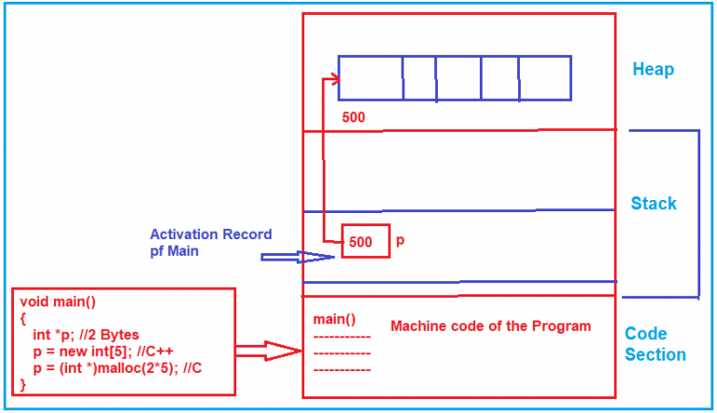

Slide 49
How the program access heap memory?
The program cannot directly access the heap memory, it has to access the pointer and the pointer will give the address of the heap memory, and then the program can reach that location and access these integers.
The heap memory should be treated as a resource.
After some time in your program, if you don’t need that array whose memory is allocated in the heap, then you need to make the pointer “p” as null which means now the pointer will not point to that memory.
The heap memory should be explicitly released or disposed. Otherwise, if we are not releasing it, then the memory will be still belonging to our program and that memory cannot be used again. So, it causes loss of memory and the loss of memory is called a memory leak.

